Slide 1
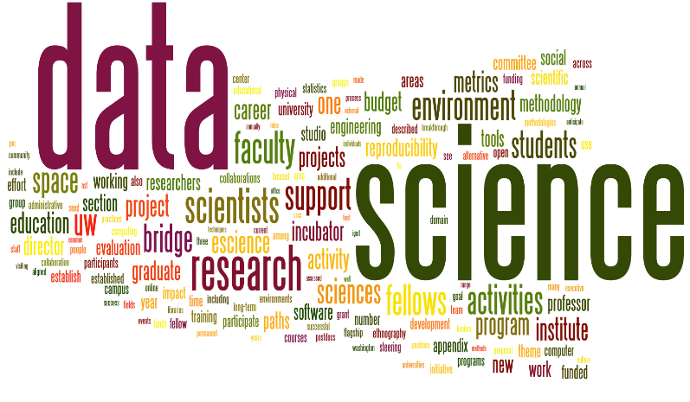
Graph
Paul Rad, Ph.D.
Associate Professor
Cyber Analytics and AI
Information Systems and Cyber Security
College of Business School
210.872.7259

Slide 2
Outline
Why Graph
History of Graph Theory
Graph Definition

Slide 3
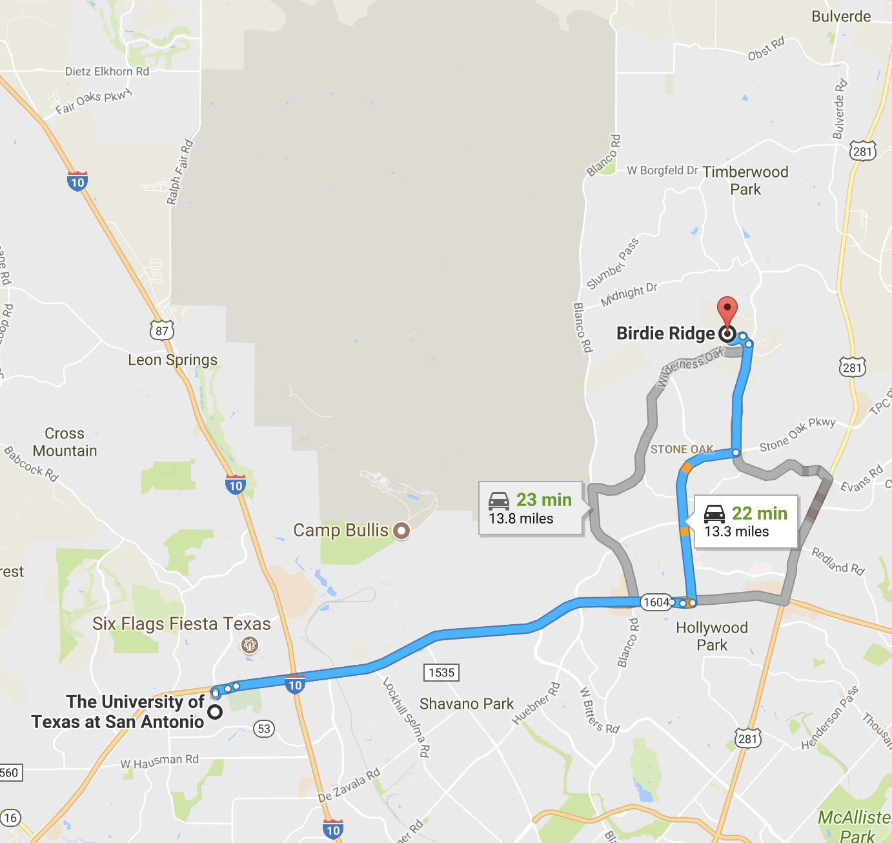
Why Networks
Nothing happens in isolation: “everything is connected, caused by, and interacting with a huge number of other pieces of a complex universal puzzle” (AL Barabasi, “Linked”)
The power of the network is in the links
However, most people don’t see the links till they are exposed to them

Slide 4
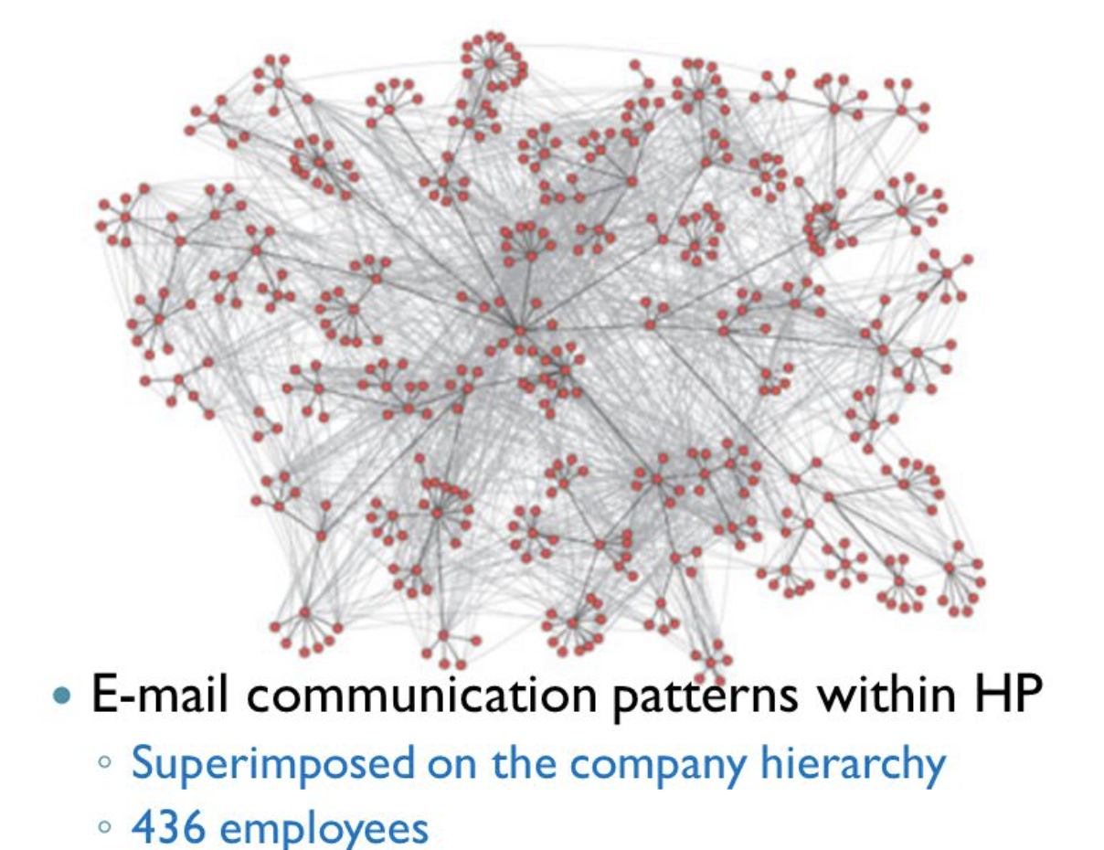
Information Network
What can we do with Networks?
Is a rumor likely to spread on this network?
Who are the most influential people in this organization?

Slide 5




Graph Theory Application
Graphs can be used to model social, biological, transportation, and other types of networks. For example we can use a graph to represent relationships among attendees at a wedding.
We note that in this network that everyone knows the bride or the groom (or both).
Question: We want to see who is best connected to both the bride and the groom.

Slide 6
Smart City
Multiple interacting networks over the same spatial domain
Transportation networks
Water and Sewage network
Power transmission network
Broadband IP and M2M network

Slide 7
State Machine - Teaching Pacman

Slide 8
Network Applications
What can we do with Networks?
Is this club, likely to split into two groups?
If so, which nodes will go to which group?
Friendship Network in a 34 person Karate Club

Slide 9
What is Analytics?
Discovery and communication of meaningful patterns or intersting insights using
Mathematical properties of data
Data computing for accessing and manipulating data
Domain knowledge to increase interpretability of data and results of analytics
Statistical modeling techniques for drawing inferences or making predictions on data

Slide 10
What is Analytics?
Uncover characteristics of data set based on its mathematical properties
Answer specific questions from multiple data sets
Develop a mathematical model for predicting the behavior of some variables
Detect emergent phenomena and explain its contributing factors

Slide 11
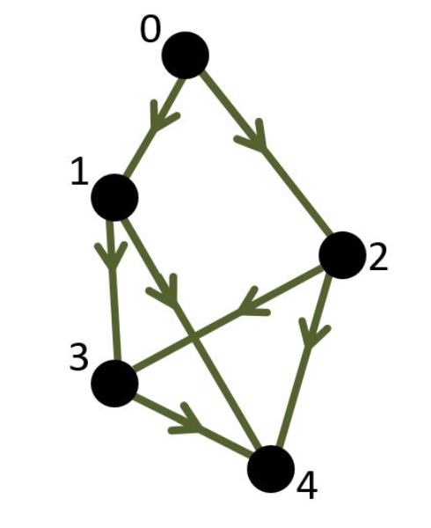
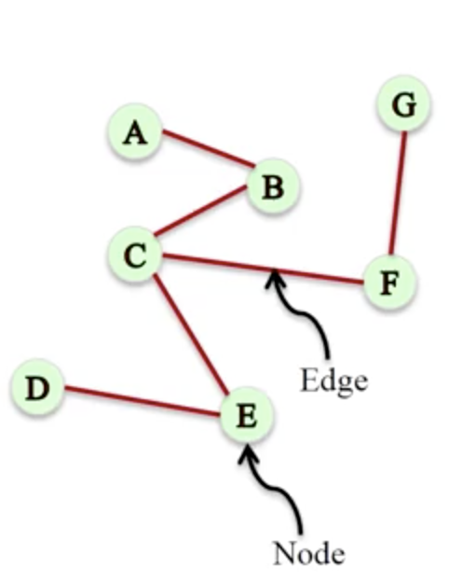
Graph Theory = Network Math Definition
Network = graph : A representation of connections among a set of objects. A graph is a set of nodes (vertices) joined by a set of lines or arrows (edge).
More formally, we define a graph G as an ordered pair G = (V,E) where
V is a set of vertices (nodes)
E is a set of edges (links).
Each edge is a pair of vertices. In other words, each element of E is a pair of elements of V.
Example: The picture above represents the following graph:
V = {1,2,3,4,5,6}
E = {{1,2},{1,5},{2,3},{2,5},{3,4},{4,5},{4,6}}
Directed/Weighted Graph
Directed Graph
Undirected Graph

Slide 12
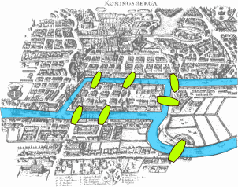
The Origin of Graph Theory
The Seven Bridges of Königsberg (the problem that is at the origin of graph theory) was posed by Leonhard Euler in 1735 (also prefigured the idea of topology)
The citizens of Königsberg supposedly walked about on Sundays trying to find a route that crosses each bridge Königsberg of exactly once, and return to the starting point.
Question: Is it possible to find a route that:
Starts and finishes at the same place?
Crosses each bridge exactly once?

Slide 13
The Origin of Graph Theory
Question: Is it possible to find a route that:
Starts and finishes at the same place?
Crosses each bridge exactly once?
e₁
X
X
e₆
e₂
W
Y
W
Y
e₅
e₄
e₃
e₇
Z
Z
A vertex : a region
An edge : a bridge between two regions

Slide 14
History
1735: Euler was puzzled by solving the bridges of Königsberg (origins of graph theory)
1950: Erdos was puzzled by social networks structure
1999: Barabasi was puzzle by the Internet
Now: we are puzzled by all of them (brain, social networks, communication and transportation networks)

Slide 15
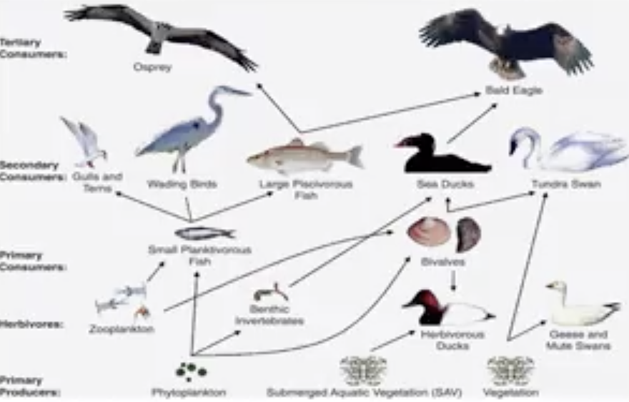
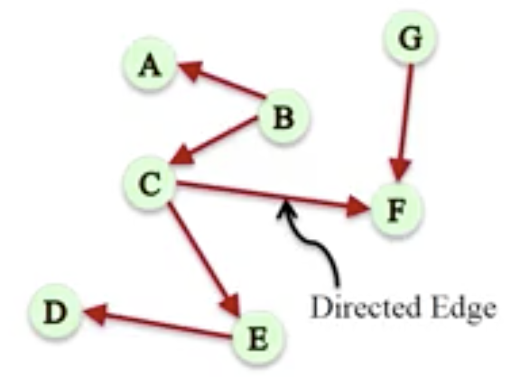
Directed Network
Asymmetric relationships
Nodes: Birds
Edges: What eats what
Edges have direction
Directed Network
Chesapeake Bay Water bird Food Web

Slide 16
Graph Network Application
Nodes: People
Edges: Number of Times they had lunch together
Undirected/Weighted Network
7
1
6
10
3
5
Weighted network: a network where edges are assigned a (typical numerical) weight.

Slide 17
Signed Network
Some networks can carry information about like or dislike
+
-
+
+
-
-

Slide 18
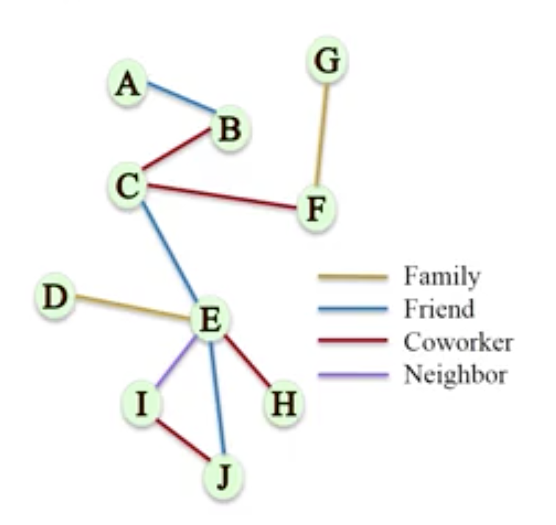
Edge Attributes
Edges can carry many other labels or attributes

Slide 19
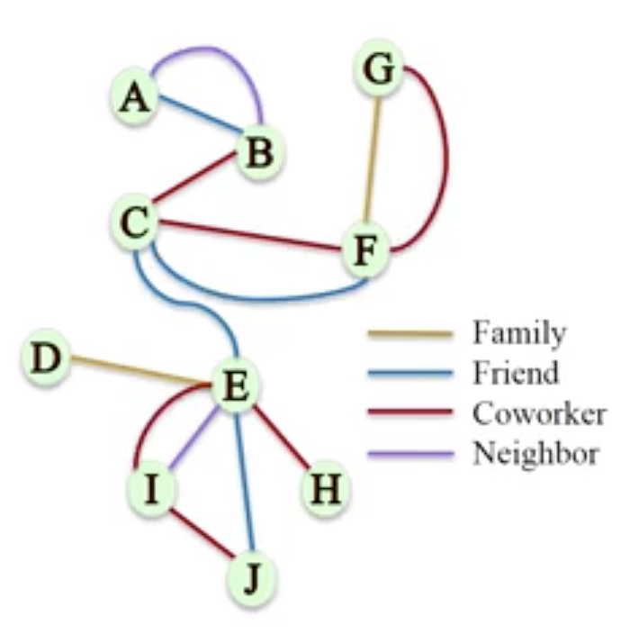
Multigraphs
A pair of nodes can have different types of relationships simultaneously
Multigraph: A network where multiple edges (parallel edges) can connect the same nodes

Slide 20
Graph Analytics
Path Analytics
Connectivity Analytics
Community Analytics
Centrality Analytics

